Slide 1

Crop Prediction
By
Sivakumar Vunnam

Slide 2

Abstarct
Main objective of this project is to predict the crop and maintain the crop
Farmers declare several months as Crop Holiday due to lack of water
Valuable time and money is lost during Crop Holiday

Slide 3
Introduction
Objectives:
Grow more than a crop in a year
Reduce the period of crop holiday
Increase in soil fertility by using natural pesticides other then artificial pesticides.
Increase the yield.

Slide 4
Scope
Provide necessary information regarding crops in a region
Information accessible in electronic format
Information includes data about:
  Old crops
  New crops

Slide 5
Vision
Provide information to
  Farmers
  Agricultural agencies
Keeping farmers with up-to-date information

Slide 6
Existing System
India has three crop seasons and one Crop Holiday
Several months are declared as Crop Holiday due to lack of water
Farmers don't have enough knowledge about new crops
Hence, they are missing several months of crop season

Slide 7
Proposed System
Build an application to educate farmers of the new crops
Eliminate idle time during Crop Holidays
Farmers can grow more than one crop a year
Thus they can reach self sustainability

Slide 8
Modules
Soil Selection Module
  Provide information regarding all crops for a selected soil type
Season Selection Module
  Crops based on seasons
Crop Selection Module
  Information regarding a particular crop

Slide 9
Used Technologies
Java
  Platform independent
  Runs on any device
Microsoft Access
  Can be used on any device

Slide 10
Requirements
Software Requirements
  Operating System: Windows XP and above
  Java
  Microsoft Access
Hardware Requirements
  Processor: Intel Pentium and above
  RAM: 512MB
  Hard Disk: 40GB

Slide 11
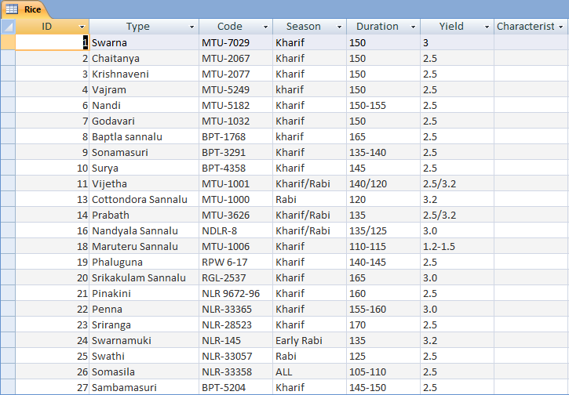
Data Table – Rice

Slide 12
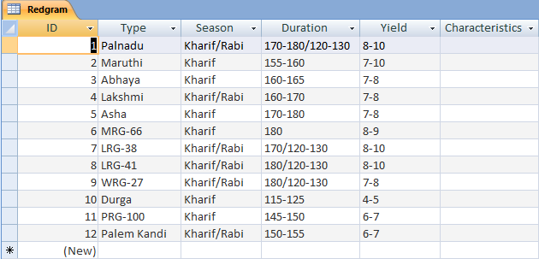
Data Table – Red gram

Slide 13
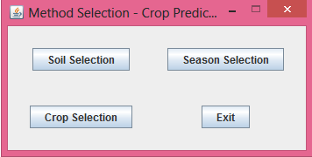
Screen Shots
Main Screen

Slide 14
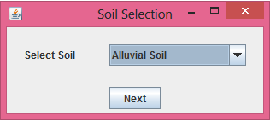
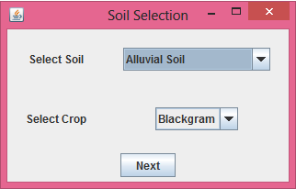
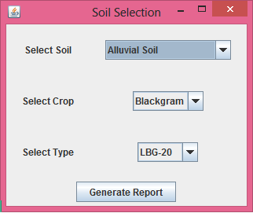
Contention..

Slide 15
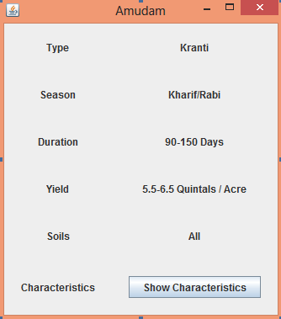
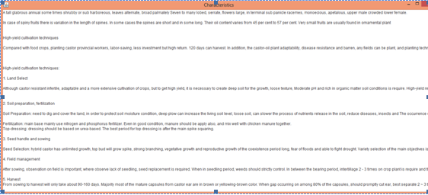
Contention..

Slide 16
Coding
rs = stmt.executeQuery("select * from " + jcb1.getSelectedItem());
while(rs.next()) {
if(rs.getString("Type").equals(jcb2.getSelectedItem().toString()))
{
if(!jcb1.getSelectedItem().toString().equals("Maize")) {
rl6.setText(rs.getString("Season"));
}
if(jcb1.getSelectedItem().toString().equals("Groundnut") |
jcb1.getSelectedItem().toString().equals("SeasameOil") |
jcb1.getSelectedItem().toString().equals("Sunflower")) {
rl10.setText(rs.getString("Yield") + " Kilos / Acre");
}
Else {
rl10.setText(rs.getString("Yield") + " Quintals / Acre");
}
if(jcb1.getSelectedItem().toString().equals("Rice")) {
rlcode2.setText(rs.getString("Code"));
}
if(jcb1.getSelectedItem().toString().equals("Groundnut")) {
rlseed2.setText(rs.getString("Seed %") + " %");
rloil2.setText(rs.getString("Oil %") + " %");
}
if(!jcb1.getSelectedItem().toString().equals("Groundnut")) {
rl8.setText(rs.getString("Duration") + " Days");
}
}
}

Slide 17
Coding
ConfigurationFile cf = new ConfigurationFile();
ArrayList<String> al=new ArrayList<String>();
if((cf.checkConfigFile())==true)
{
al=cf.readConfigFile();
if(al.get(0).equals("LoadDataBaseFile")&(al.get(1).endsWith(".mdb")|al.get(1).endsWith(".accdb")))
loadFile(al.get(1));
else
try
{
loadFile(cf.writeConfigFile(false).getCanonicalPath());
}
catch (Exception e)
{
e.printStackTrace();
}
}
else
try
{
loadFile(cf.writeConfigFile(false).getCanonicalPath());
}
catch (Exception e)
{
e.printStackTrace();
}
createGUI();

Slide 18
Conclusion
Critical information and data required has been verified with Professionals
This project would help farmers extend their knowledge
Thus helps in increasing crop productivity in a timely manner

Slide 19
Biblography
[1] Avi Silberschatz, Henry F. Korth, S. Sudarshan, Database System Concepts, Tata McGraw-Hill Publications.
[2] Dr. Gogineni Veerendhranath, Vyavasaya Panchangam 2008-2009, Agricultural Information and Publications Centre, Acharya N.G. Ranga Agricultural University.
[3] Dr. K.T. Chandy, Classification of Crops, Booklet No. 227 - Agricultural Extension: & Education: AEES-2.

